Slide 1
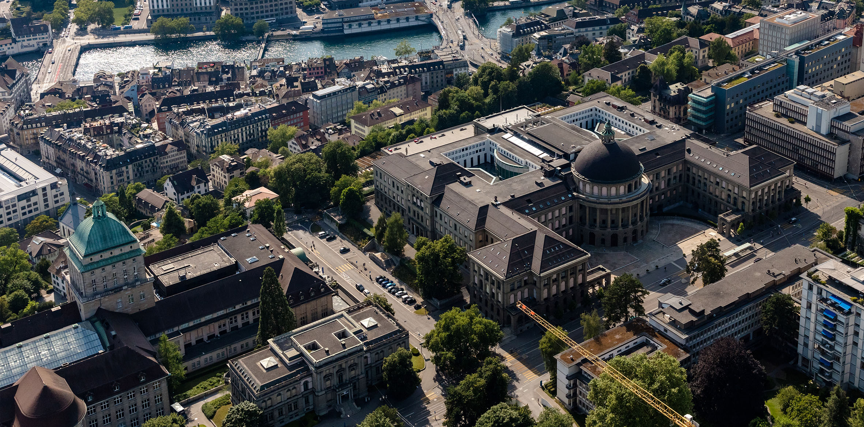
Image Pipeline for DHM
Fabian Braun
Master Thesis
Supervisor: Prof. Dr. R. Stocker
Advisor: D. Baumgartner
07. September 2023, Zurich

Slide 2
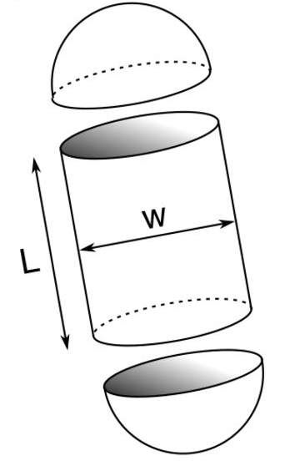
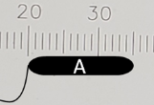

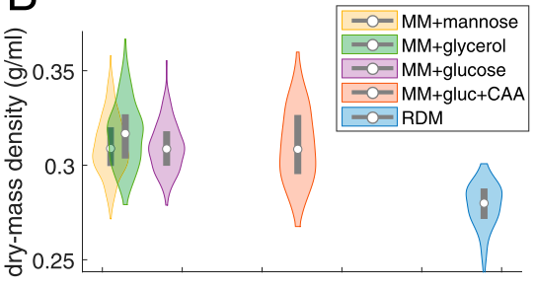

Research Goal: how do bacteria accumulate biomass
Goal of any organism: maximize biomass based on available resources.
Models for bacteria are based on biomass, but often only length is measured.
Literature assumption:
Length
Volume
Mass
L
w
Questionable assumption that density is constant:
Oldewurtel, 2021
Notes:
Label-free imaging: No contrast agant or dye needed -> living cells
Non-invasive: Does not damage or alter imaged samples -> suitable for long-term observations of living cells and tissues
High Sensitivity to Thickness -> sutable for studying cell morphology
Quantitative measurements: quatitative information about optical path length changes -> cell volume, dry mass, intracellular refractive index
High-throughput imaging: Can be adepted for high-throuput imaging systems, allowing for analysis of large sample populations and fast changing samples
Three-dimensional reconstruction: True 3 dimensional imaging by taking several images from all sides, pseudo-3d, by changing the focus distacne -> tracking
Multimodal imaging: Can be combined with other imaging modalities such as fluorescence microsopy or brightfield imaging- > comprehensive view of the sample‘s properties

Slide 3
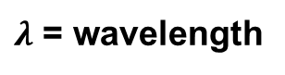
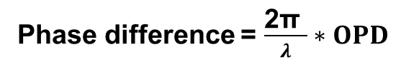
Measuring dry mass with the phase difference image
Mass can be measured by measuring the phase difference.
Generally the denser the material the slower the speed of light
Sample
Optical path difference (OPD)
Coherent light source
Phase difference = $\frac{\text{2}\text{π} }{λ}∗OPD$
$λ$ = wavelength
Cell
2π
Methods measuring the phase shift are called quantitative phase imaging (QPI).
Notes:
Label-free imaging: No contrast agant or dye needed -> living cells
Non-invasive: Does not damage or alter imaged samples -> suitable for long-term observations of living cells and tissues
High Sensitivity to Thickness -> sutable for studying cell morphology
Quantitative measurements: quatitative information about optical path length changes -> cell volume, dry mass, intracellular refractive index
High-throughput imaging: Can be adepted for high-throuput imaging systems, allowing for analysis of large sample populations and fast changing samples
Three-dimensional reconstruction: True 3 dimensional imaging by taking several images from all sides, pseudo-3d, by changing the focus distacne -> tracking
Multimodal imaging: Can be combined with other imaging modalities such as fluorescence microsopy or brightfield imaging- > comprehensive view of the sample‘s properties

Slide 4
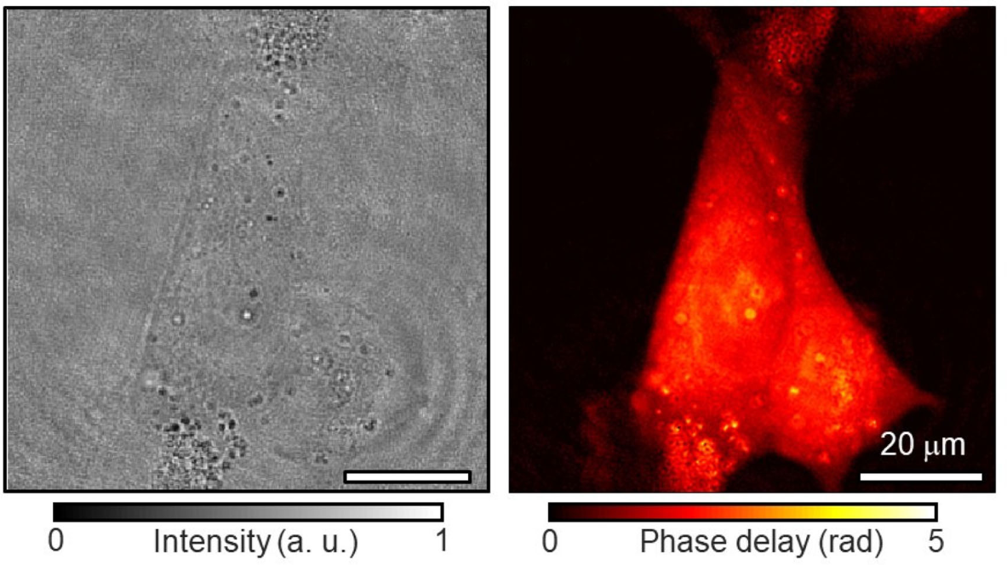
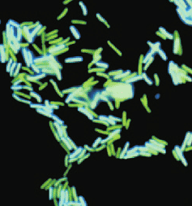
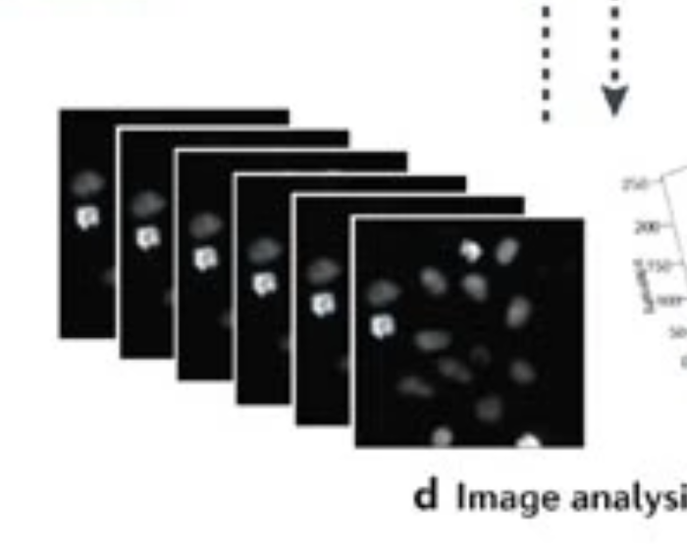
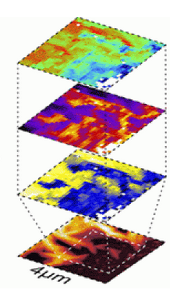
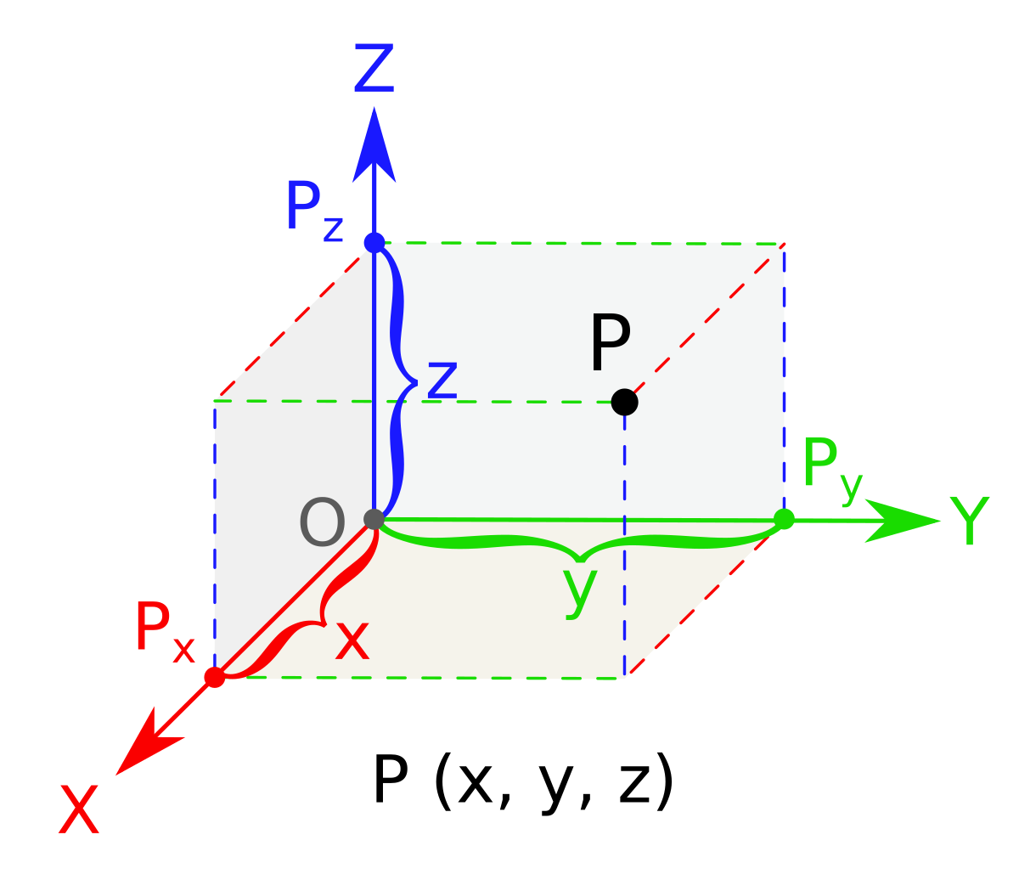
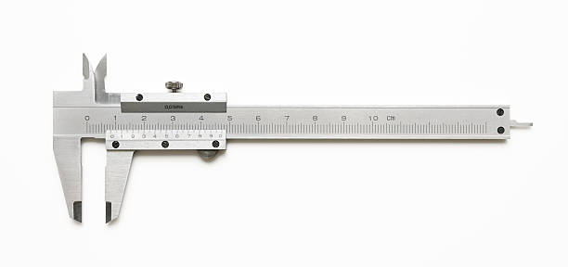
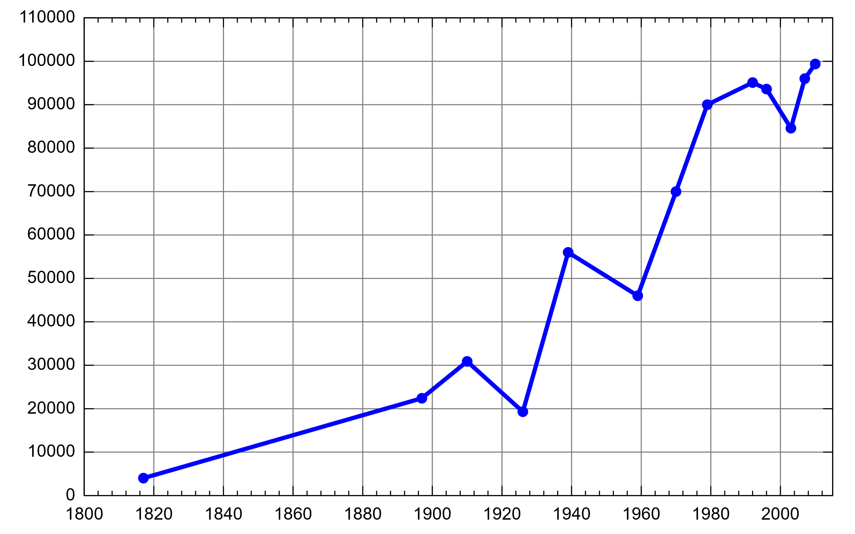
Why are we interested in quantitative phase imaging (QPI)?
Intensity
Phase
Digital holographic Microscopy (DHM) is one of many QPI methods.
Cells and bacteria are generally phase object, hardly visible by eye.
Advantages:
Label-free imaging, non-invasive
High Sensitivity to thickness
Quantitative measurements
High-throughput imaging
Three-dimensional reconstruction
Multimodal imaging
Notes:
Label-free imaging: No contrast agant or dye needed -> living cells
Non-invasive: Does not damage or alter imaged samples -> suitable for long-term observations of living cells and tissues
High Sensitivity to Thickness -> sutable for studying cell morphology
Quantitative measurements: quatitative information about optical path length changes -> cell volume, dry mass, intracellular refractive index
High-throughput imaging: Can be adepted for high-throuput imaging systems, allowing for analysis of large sample populations and fast changing samples
Three-dimensional reconstruction: True 3 dimensional imaging by taking several images from all sides, pseudo-3d, by changing the focus distacne -> tracking
Multimodal imaging: Can be combined with other imaging modalities such as fluorescence microsopy or brightfield imaging- > comprehensive view of the sample‘s properties

Slide 5
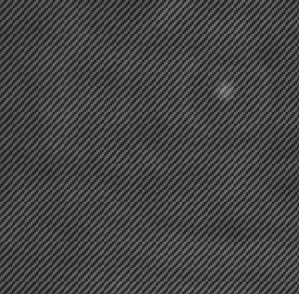

Digital holograpic Microsopy (DHM)
DHM acquisition
Hologram
Hologram
L
CCD
BS
M
R
θ
O
Z
X
Scope
R
Sample
O
Source
Applications:
Phase image
3D tracking
Phase image
M
BS
L

Slide 6
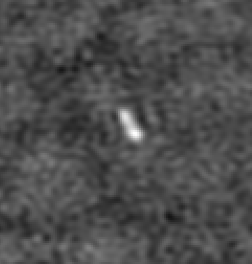
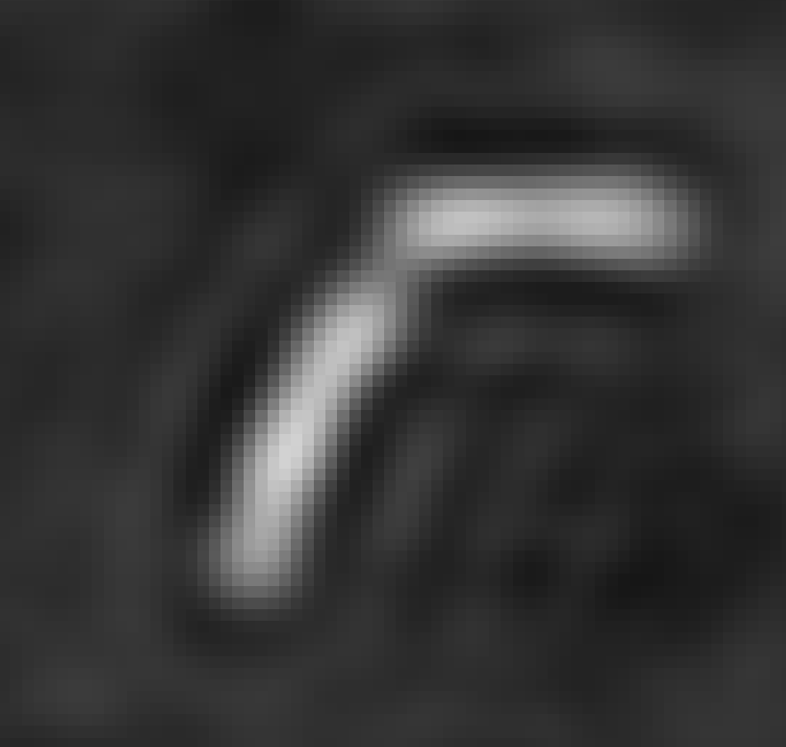
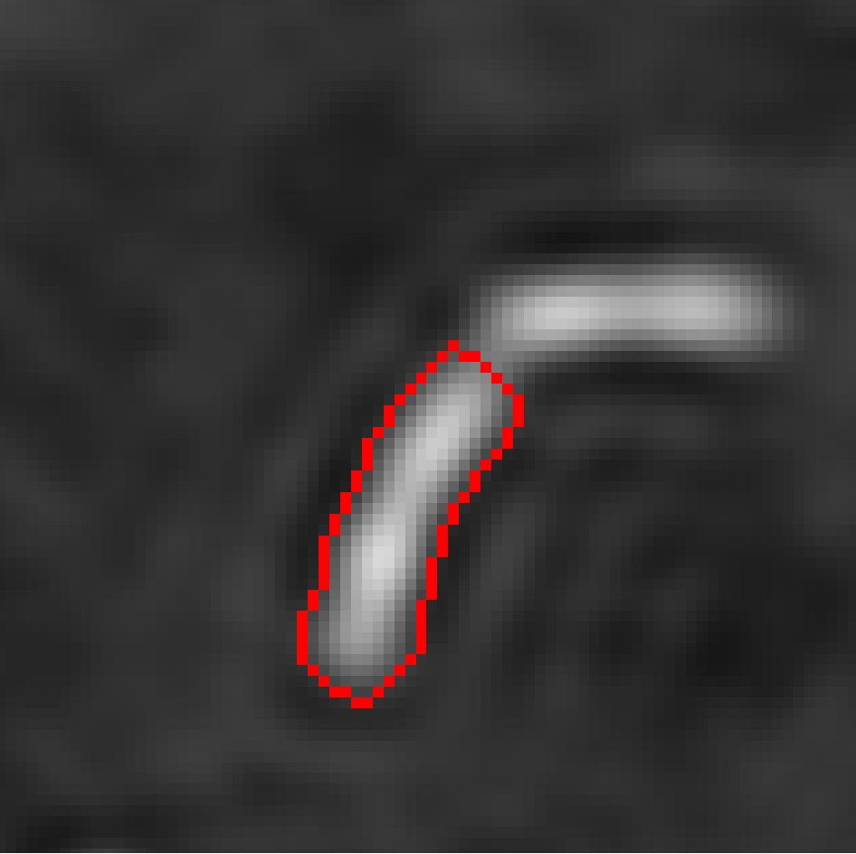
The pipeline consists of two parts
Phase image construction
Segmentation and lineage tracking
Hologram
Phase image
Construction
Segmentation and tracking

Slide 7

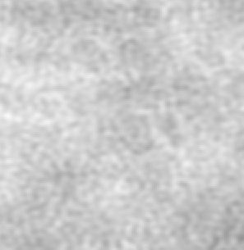
DHM-Image reconstruction with LyncéeTec Koala
Sample
Phase image
Hologram
Reconstruction dist.
Intensity image
Bacteria
Single focus plane
Notes:
Propagation to reconstruction distance

Slide 8
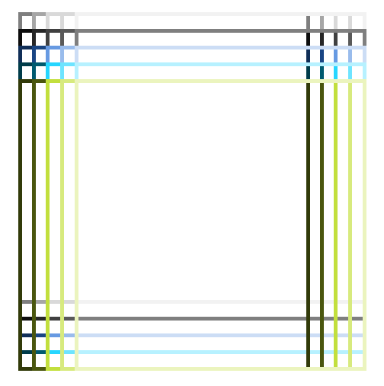
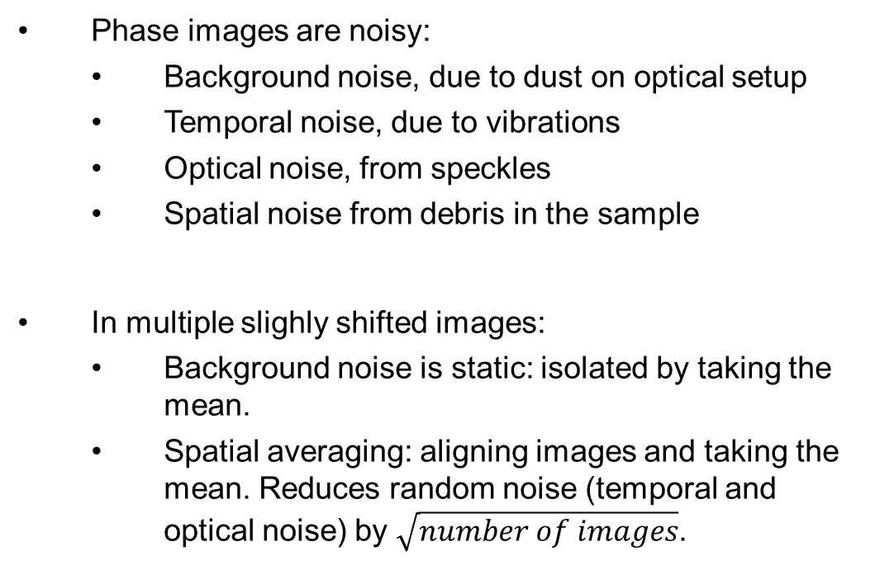
Noise reduction methods
Cell culture
Phase images are noisy:
Background noise, due to dust on optical setup
Temporal noise, due to vibrations
Optical noise, from speckles
Spatial noise from debris in the sample
In multiple slighly shifted images:
Background noise is static: isolated by taking the mean.
Spatial averaging: aligning images and taking the mean. Reduces random noise (temporal and optical noise) by $\sqrt{number of images}$.
Images
Close up
shifts

Slide 9

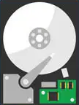
Changes to previous workflow
Before
Phase Image
Hologram
Avg. Phase Image
Set focus
Intensity Image
~1 MByte
~2 MByte each
Now
~125 MByte per avg. Image
Hologram
Avg. Phase Image
~25 MByte per avg. Image
Focusing
Spatial avg.
~1 MByte

Slide 10
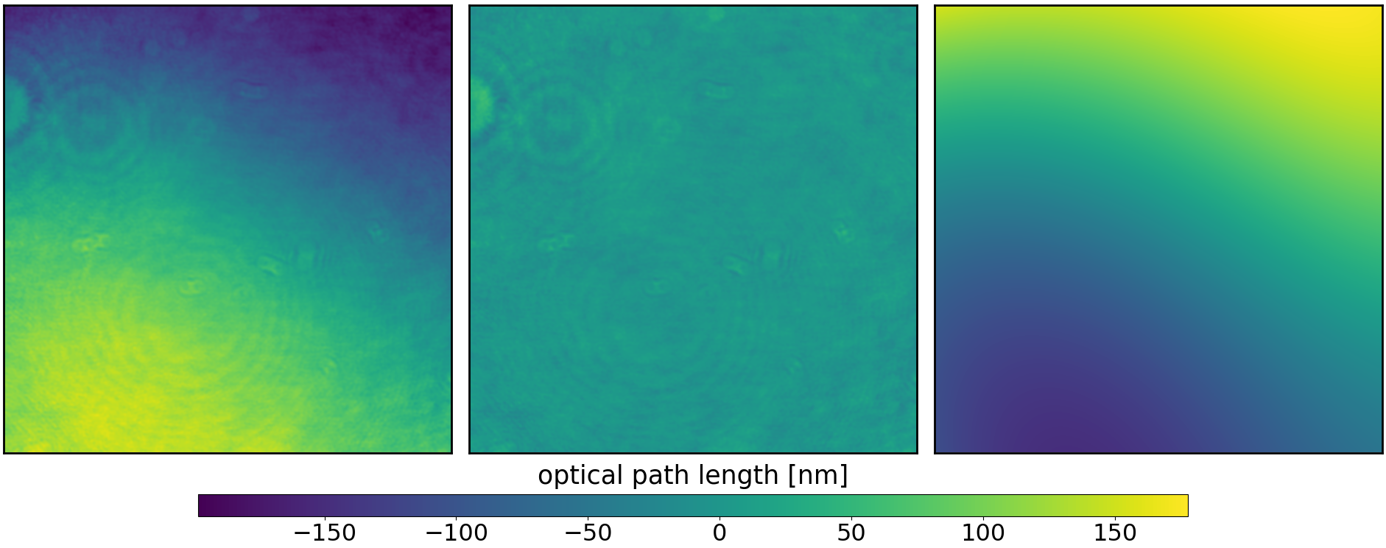
Process 1: surface plane subtraction
Plane subtr.
Uneven surface: Caused by imperfect alignment of optical instruments in DHM.
Subtraction with Koala only possible during experiment and not in postprocessing
Surface: Adjusted using linear regression on polynomial features of pixels coordinates (x and y).
Focusing
Background subtr.
Spatial averaging
Before
After
Difference

Slide 11
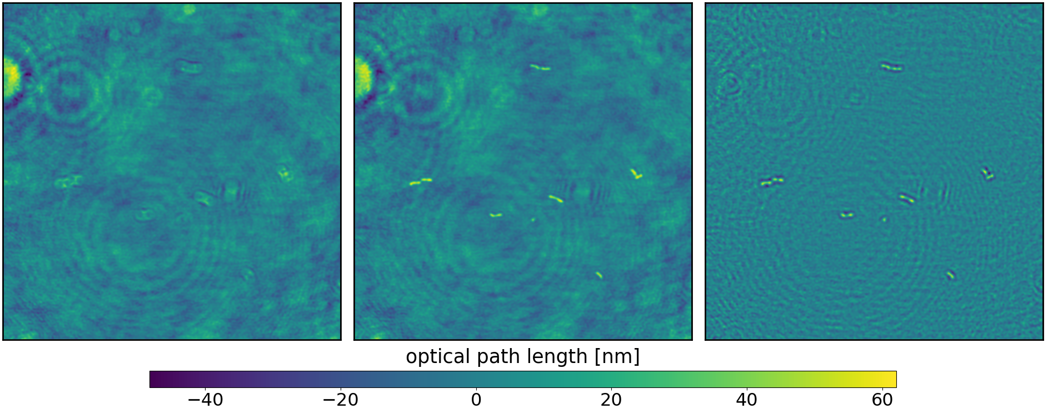
Process 2: focusing
Plane subtr.
Focusing
Deviation from set focus distance: Unknown reason and also unpredictable
Automatic focusing: Based on image features
Image depicted has a strong focus deviation.
Background subtr.
Spatial averaging
Before
After
Difference

Slide 12
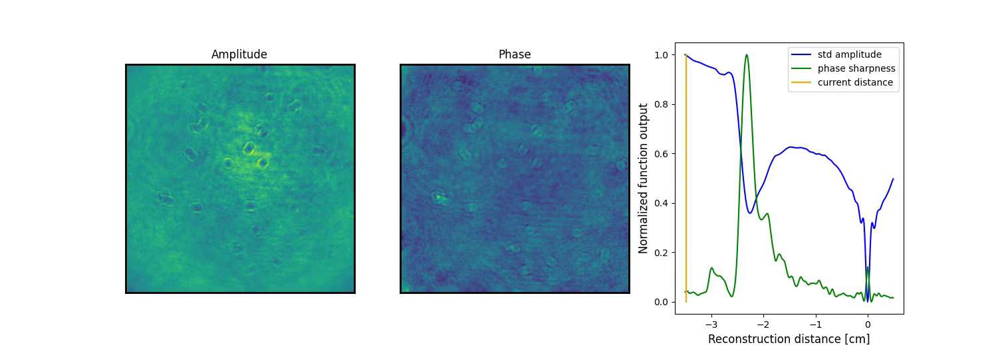
Images with various reconstruction distances
Klar mache, das reconstruction und focus
Find region of focus with maxima of phase sharpness.
Find exact single global focus plane with minimum of std(amplitude).

Slide 13
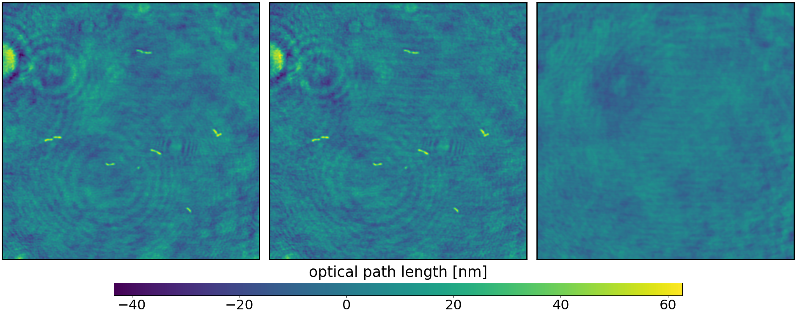
Process 3: background subtraction
Plane subtr.
Focusing
Static Noise: Dust or other disturbances on the optical system
Median of unshifted image stack
Calculated on the first ten timesteps as later images can get croweded
Background subtr.
Spatial averaging
Before
After
Difference

Slide 14
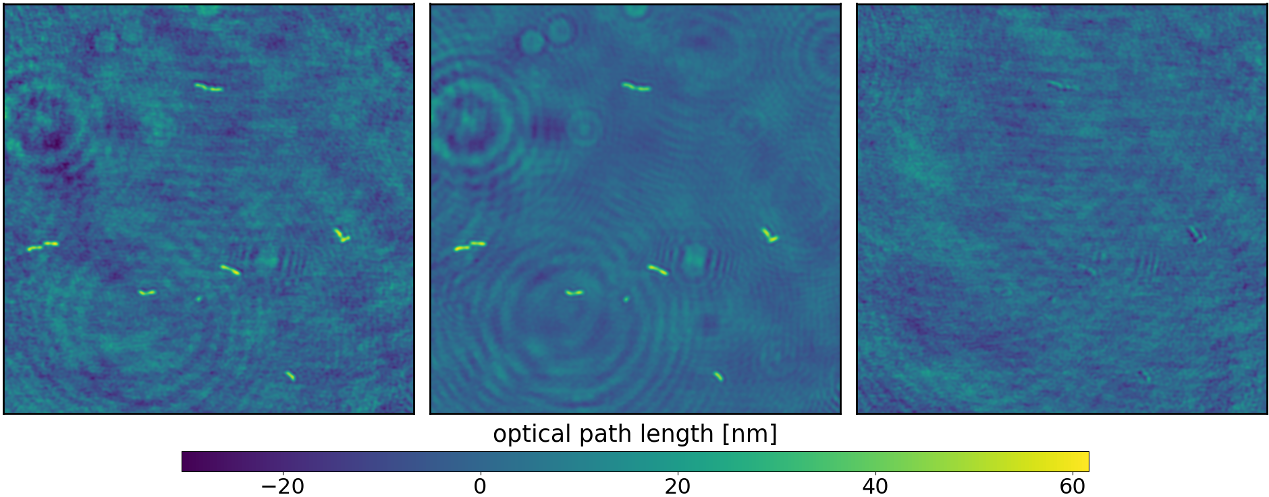
Process 4: spatial averaging
Plane subtr.
Focusing
Reduces random noise.
Calculates relative shifts between images using phase cross correlation.
Stacks shifted images, calculates the average, and then trims the outer portion.
Background subtr.
Spatial averaging
Before
After
Difference

Slide 15
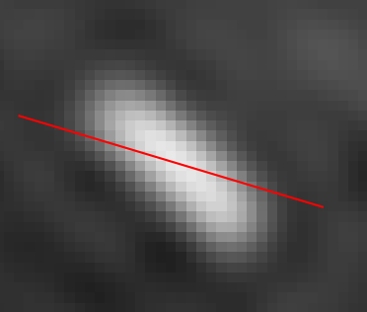
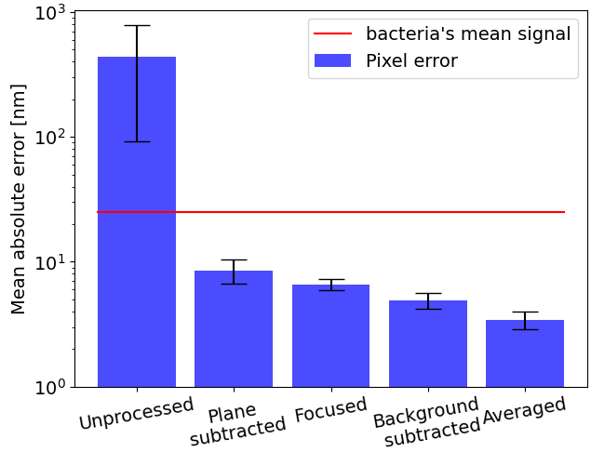
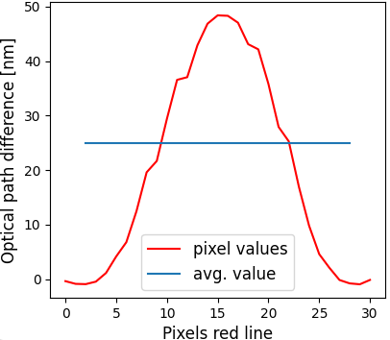
Results: per pixel error
Data based on 1600 images, mean signal of a bacteria is ~25 nm.
Error measured on background, except for focusing → unfocused vs. focused
Few images are significantly out of focus.

Slide 16
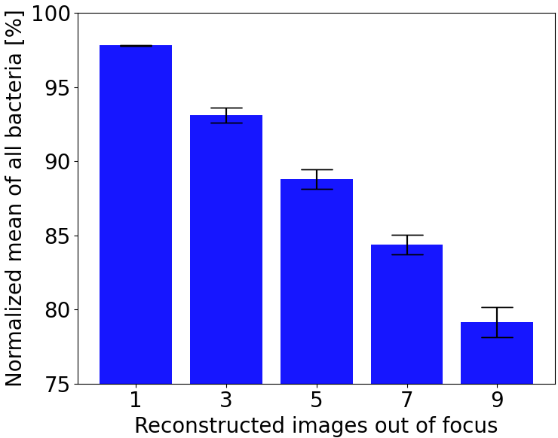
Results: focusing
Focus error has a none zero mean → considerable decrease in mass
Figure shows mass is decreased with n of 25 images 1cm out of focus.

Slide 17
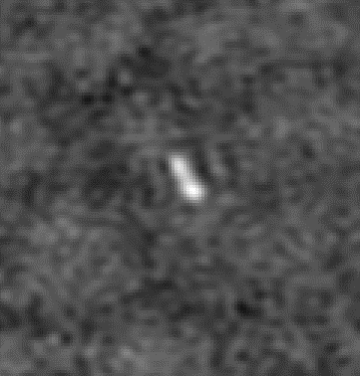
Pipeline part two
Phase image construction
Segmentation and lineage tracking
Hologram
Phase image
Construction
Segmentation and tracking

Slide 18



Previous workflow for segmentation and tracking
Phase images
Segmentation
Interpretation
Tracking
Results
Ilastik
Problems:
Ilastik does not generalize well: each experiment has to be segmented.
Dependent on human segmentation → not objective, especially over time
A lot of manual work

Slide 19
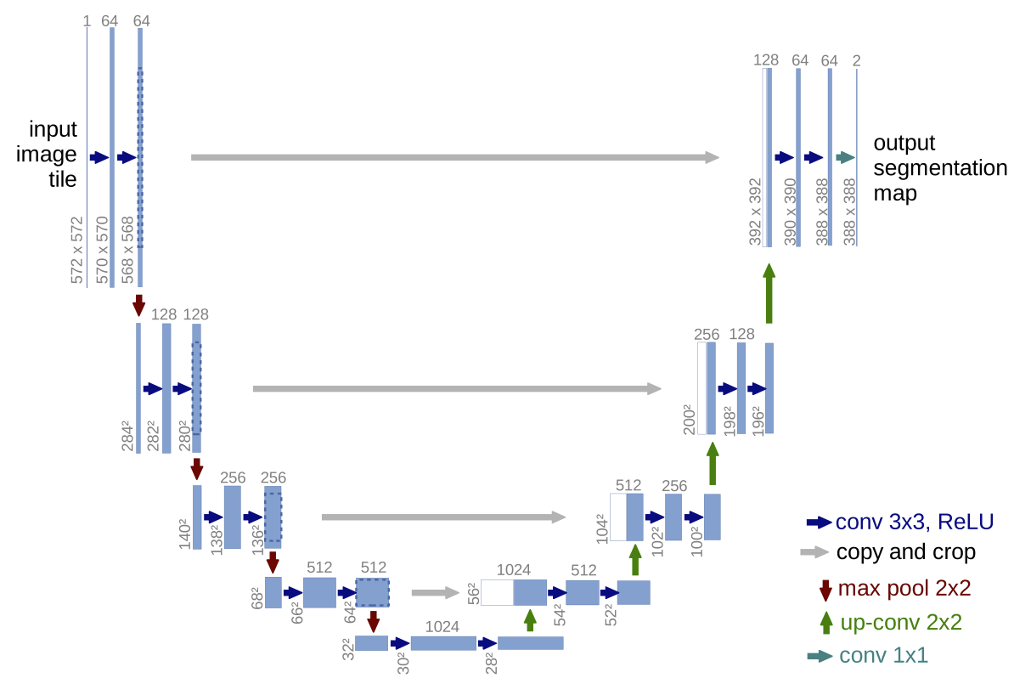
Segmentation and Tracking with U-Net
U-Net is a neural network and the current standard in biological image processing.
Encoder-decoder structure.
Skip connections: preservation of spatial information and multilevel feature interaction
Data augmentation allows the model to generalize well even with few data.
Deep Learning for Time-Lapse Analysis (DeLTA) is based on the U-Net and used in this work.
Skip connections

Slide 20
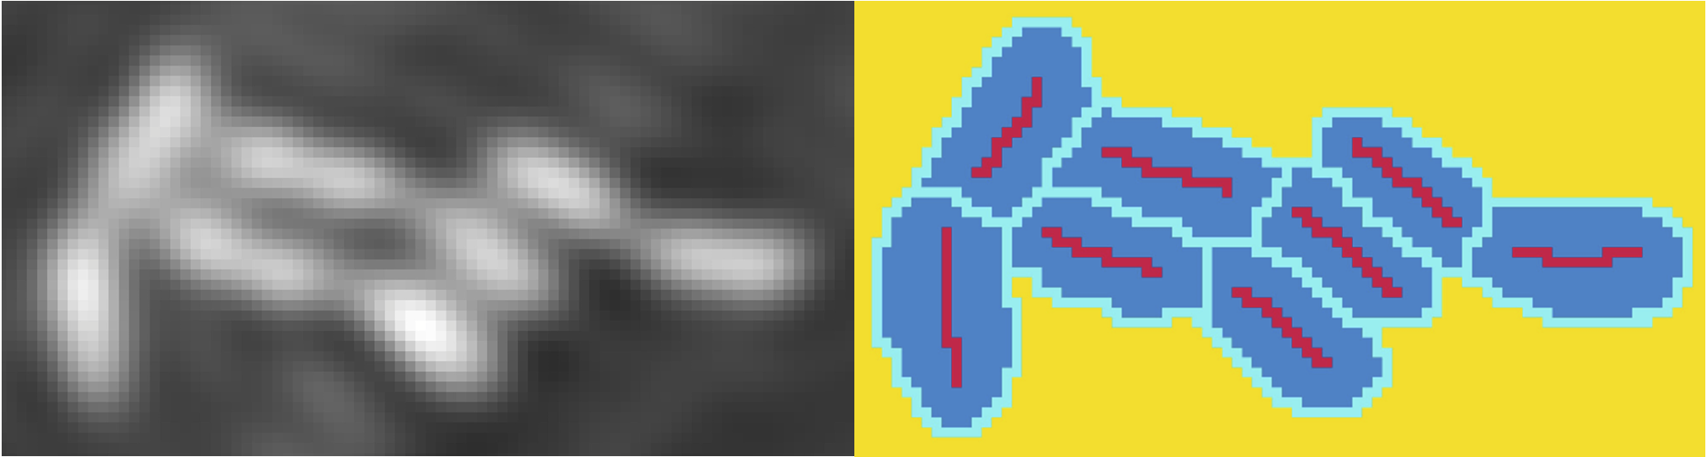
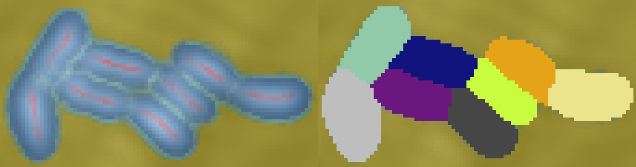
Preparation of training data: Segmentation with Ilastik
Manual pixel categorization
Train Ilastik by categorizing pixels into core, bacteria, boundary and background.
Prediction of other pixels based on preselected feature set
Separation between bacteria based on core.
Full size based on the bacteria
Ilastik‘s learned segmentation

Slide 21
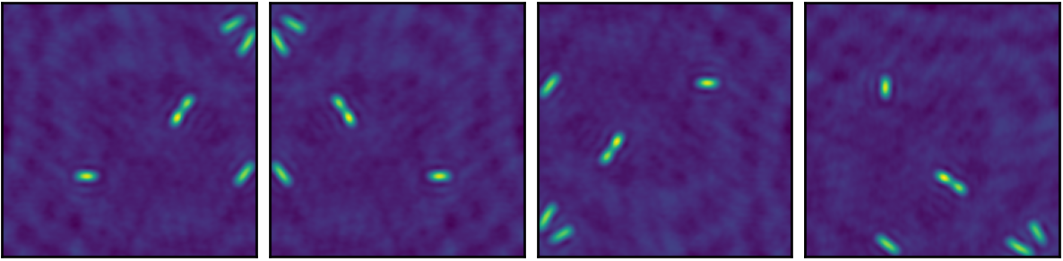
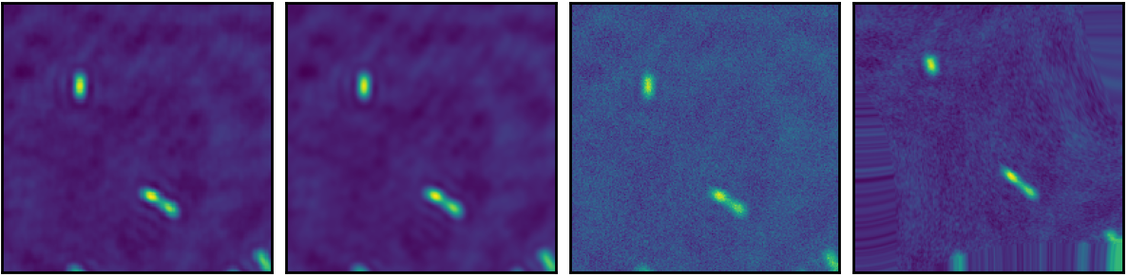
Training data augmentation methods
Original
Horizontal flip
Vertical flip
Rotation
Zoom
Gaussian blur
Gaussian noise
Elastic deformation

Slide 22
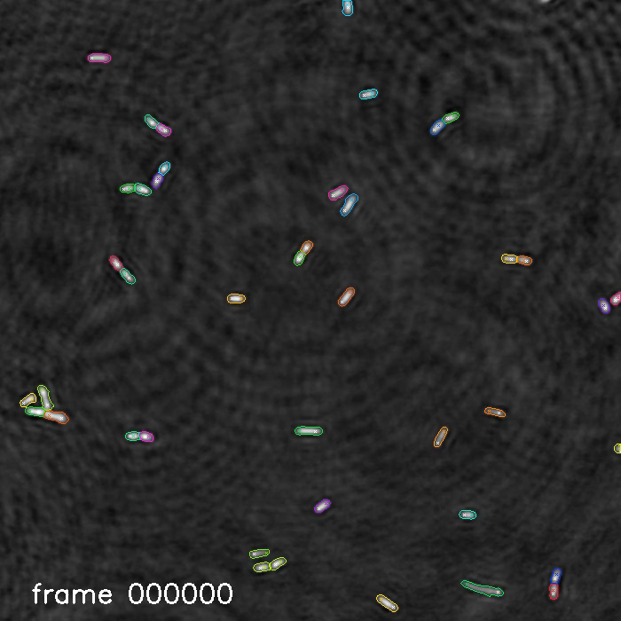

Results: Time-lapse video of bacterial growth and linage tracking
$$\frac{2min}{frame}$$
15 µm

Slide 23
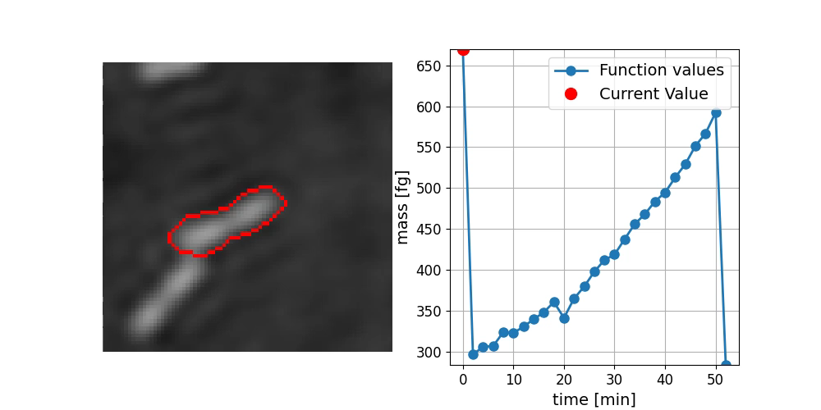
Output linage with features, cell cycles
2 µm

Slide 24
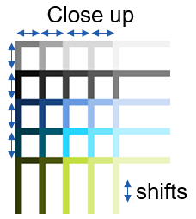
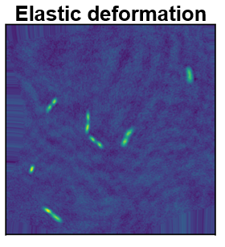
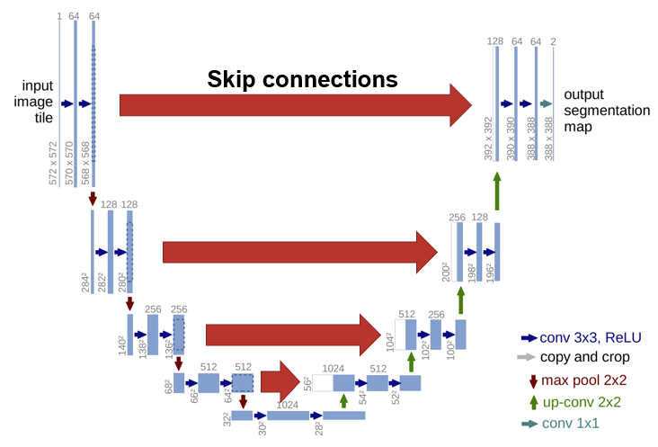
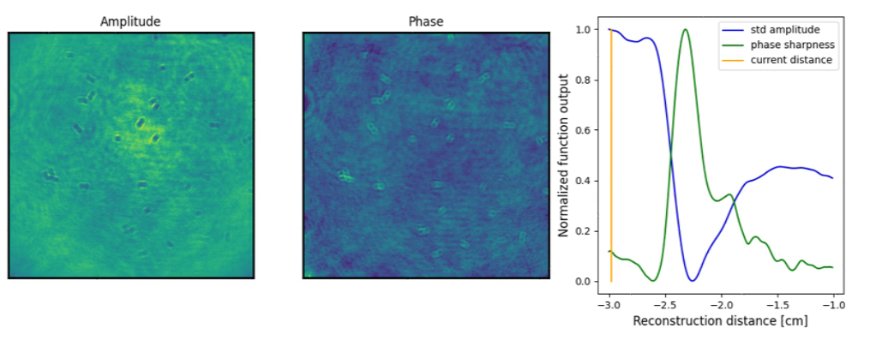
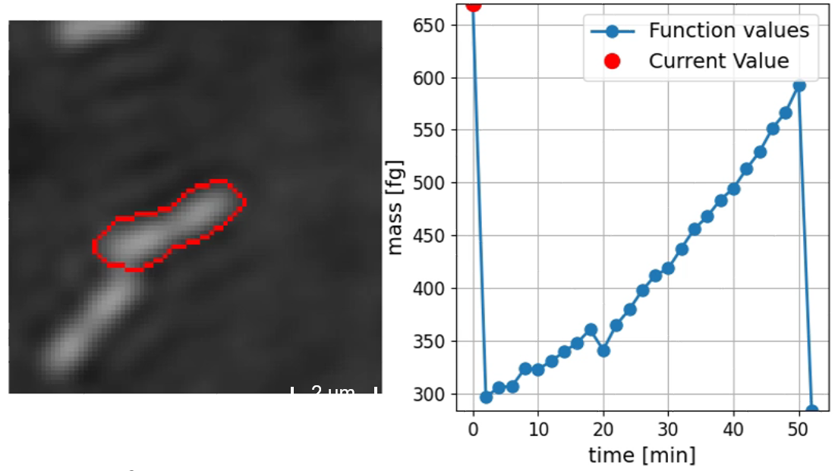
Summary
An automatic focusing has been implemented
Storage space is reduced by a factor of 5
Automated segmentation and tracking with the help of a U-Net
Visual and easy to use output files
Easy to expand with other image types (brightfield, fluorescent)
Pipeline

Slide 25
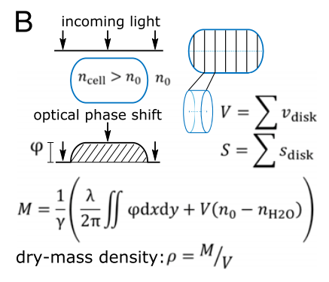
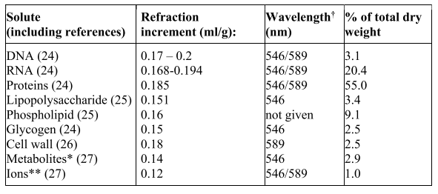
Phase image → Mass
Calculate optical path volume (minus bacteria volume * difference in refractive index) * 1/refractive increment
refractive increment from table, by knowing the composition of the bacteria

Slide 26
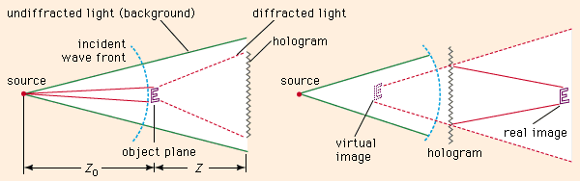
How does a holgram work?
In 1948 D. Gabor found principle that captures both amplitutde and phase information of an object using interference pattern.
Gabor's hologram is essentially the record of this interference pattern between an object beam and a reference beam on a photosensitive medium.
When the developed hologram is lit with the same light, the object beam reappears.
This object beam can be followed back; focus is achieved when the object distance matches the difference between object and hologram planes.
britannica.com/technology/holography

Slide 27
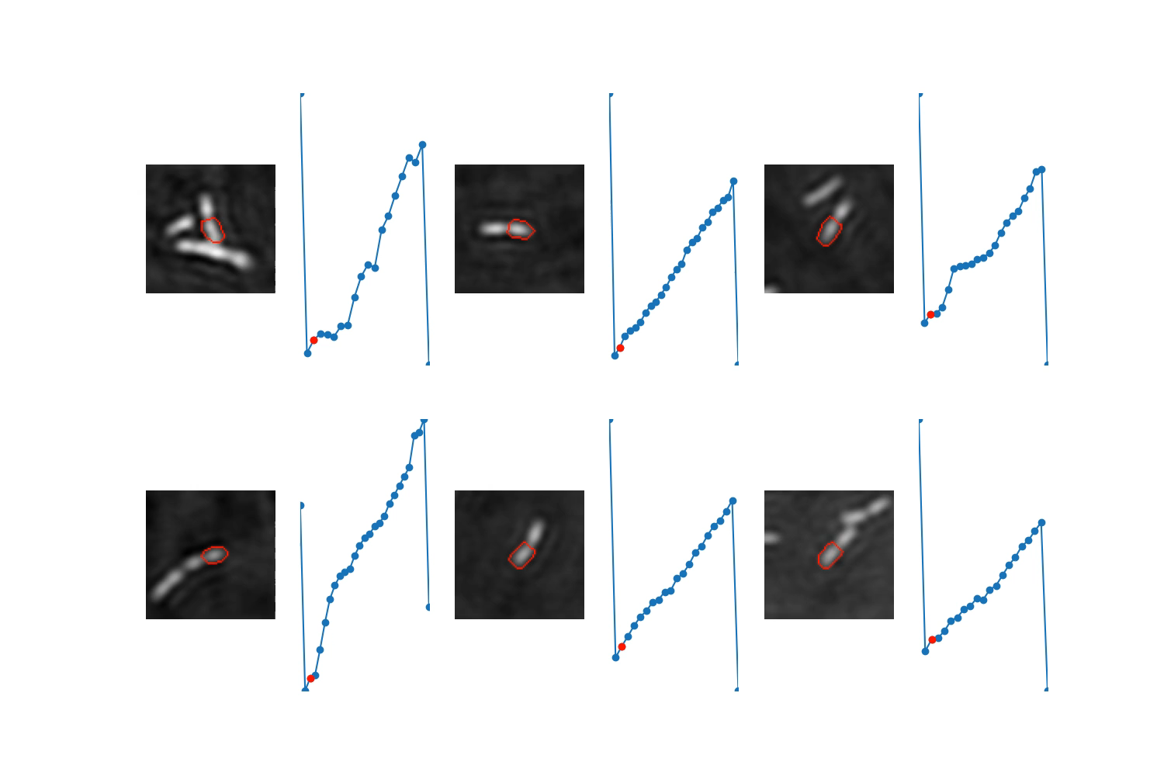
Outlook
Improve training data generation, by consentrating on a smaller but more precise image batch.
Multimodal approach: combining with fluorescent or brightfield images

Slide 28
Pros and cons
Pros:
Decrease in storage space by a factor of 5
Automated focus distance detection
No segmentation training needed for each induvidual experiment
Easily to use and visual output files
Pipeline combines all processes into one easy to use script
Cons:
Post processing time is increased
Segmentation accuracy is not improved

